Slide 1

DriverPass System Analysis
Trevor Williams
Notes:
[No speaker notes required for this slide.]

Slide 2

System Requirements
Users can create accounts and log in
Customers can schedule driving lessons
Customers can take online practice tests
Staff can manage users and schedules
System must be secure and reliable
Notes:
The DriverPass system is intended to assist both employees and clients. Clients must be able to register, log in, plan classes, and take online practice exams. Employees require tools to handle consumer data and scheduling. In order to safeguard user data, the system must also be dependable and secure. These specifications aid in making the DriverPass experience seamless and well-organized.

Slide 3
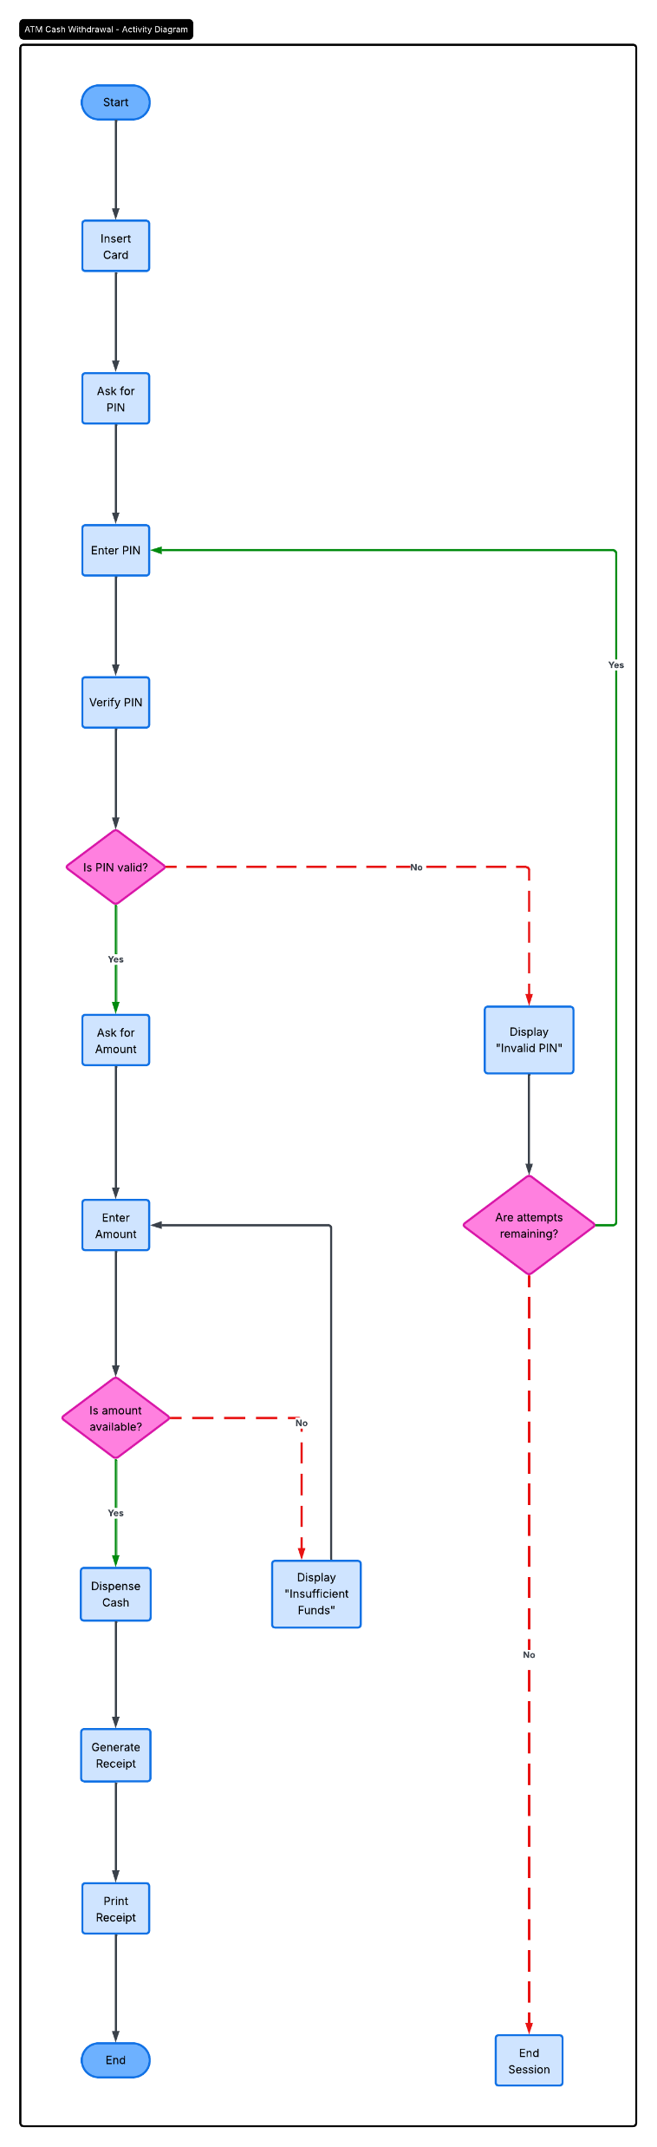
Use Case Diagram
Notes:
The DriverPass system is intended to assist both employees and clients. Clients must be able to register, log in, plan classes, and take online practice exams. Employees require tools to handle consumer data and scheduling. In order to safeguard user data, the system must also be dependable and secure. These specifications aid in making the DriverPass experience seamless and well-organized.

Slide 4
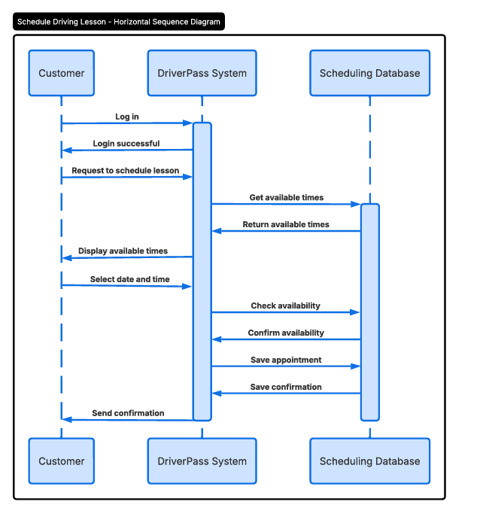
Activity Diagram
[Inhere.]
Notes:
The steps a consumer must take to schedule a driving lesson are depicted in this figure. The consumer logs in and chooses a class to start the process. After that, the system displays the times that are available and determines whether the chosen time is open. The lesson is confirmed if it is accessible. If not, the client selects a different time. This avoids disputes and keeps scheduling structured.

Slide 5
Security
User login with username and password
Different access levels for users
Protection of personal data
Regular system updates
Backup and recovery
Notes:
Because the system stores schedule and personal data, security is crucial. Users have varying degrees of access, and they must log in with secure credentials. This stops unwanted access. Additionally, the system has backups in case something goes wrong and safeguards saved data. These aspects contribute to the company's and its clients' safety.

Slide 6
System Limitations
Requires internet access
Depends on updated DMV information
Cannot guarantee test success
Requires maintenance and updates
Notes:
Despite its usefulness, the method has certain drawbacks. Users may experience problems if they have a bad connection because it depends on internet access. To be accurate, it also depends on current DMV data. Although the system assists users in getting ready, it cannot ensure that they will pass the test. Lastly, the system needs to be updated and maintained on a regular basis in order to function correctly.

